Slide 1
RESONANT
ELECTROPHYSIOLOGY
100× More EMG Channels via Frequency-Domain Multiplexing
Project Progress Review
Juan Diego Sanchez | UCI Samueli Engineering | May 2026

Slide 2
Agenda
01
The Problem
Why current EMG systems are limited
02
Proposed Solution
Frequency-domain multiplexing concept
03
Signal Processing Requirements
What each resonator must provide
04
Samantha's First Approximation
Initial circuit design and equations
05
Active Q-Enhancement Approach
Simulations, IGZO path, power needs
Resonant Electrophysiology - UCLA/UCI Collaboration
2 / 16

Slide 3
The Problem
Current EMG systems hit a hard ceiling on channel count
The Bottleneck
Goal
Traditional EMG: one dedicated trace per electrode
Surface EMG cannot resolve individual muscle fibers (forearm has ~18 muscles)
Cross-talk between superficial and deep muscles is unsolvable externally
Current systems: tens of channels max
100×
more channels
From ~10 to 1000+ EMG channels
on a single transmission line
Resonant Electrophysiology - UCLA/UCI Collaboration
3 / 16

Slide 4
Why This Matters
From limited monitoring to electrophysiological imaging
01
02
03
04
Prosthetic Control
Stroke Recovery
Cardiac Monitoring
Neural Interfaces
Fine-grained motor unit decoding enables natural prosthetic limb control
Single-fiber resolution to track muscle re-innervation during rehabilitation
Same technology applicable to arrhythmia mapping (NHLBI applications)
Scale to brain recording for novel BCI applications (NIH R01 targets)
Long-term: enable "electrophysiological imaging" — 3D reconstruction of electrical activity
Resonant Electrophysiology - UCLA/UCI Collaboration
4 / 16

Slide 5
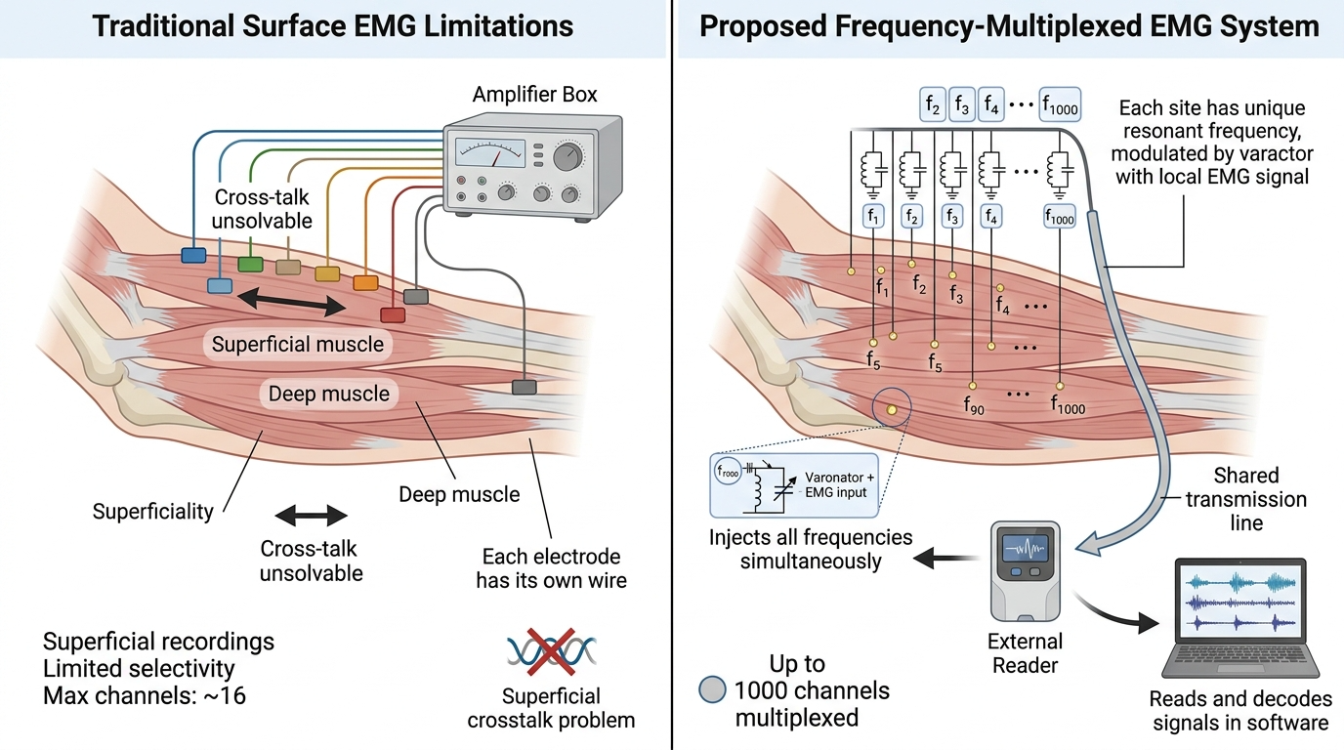
Proposed Solution: Frequency-Domain Multiplexing
Like FM radio, but for thousands of biopotential channels
The Concept
Each electrode site has its own unique resonant frequency
All resonators sit on a single shared transmission line
The EMG signal at each site modulates its resonator's frequency (via varactor)
External reader injects all frequencies simultaneously and decodes them in software
EMG signal shifts each notch slightly → signal recovered via DSP
Resonant Electrophysiology - UCLA/UCI Collaboration
5 / 16

Slide 6
How the Signal Flows
Two separate signal systems — biopotential and carrier — connected by the varactor
Outside the Body (Reader)
Inside the Body (Implant)
Signal Generator emits sum of sinusoids at all carrier frequencies
Signal passes through skin via capacitive coupling
Returns through skin after passing through implant
ADC samples returning signal at >50 MSPS
DSP algorithm recovers individual channel phases
Carrier sinusoids travel along the transmission line
Each resonator couples to the TL via coupling capacitors
Pair of electrodes per resonator senses local EMG (μV-mV)
EMG voltage modulates varactor capacitance C(V)
Resonance frequency shifts → phase change on carrier
Key insight: the EMG signal never enters the transmission line — it modulates the resonator
Resonant Electrophysiology - UCLA/UCI Collaboration
6 / 16

Slide 7
What Each Resonator Must Deliver
Software-driven requirements — independent of circuit implementation
Samantha's DSP algorithm requires each resonator to provide phase information at a unique frequency. This imposes three hard requirements:
f₀
Q
φ
Unique Resonant Frequency
High Quality Factor
Clean Phase Response
Each channel occupies its own narrow band in the 50-200 MHz range. With 1000 channels in 150 MHz available, each gets 150 kHz of bandwidth.
Notch −3dB bandwidth must be ≥5× smaller than channel spacing to prevent crosstalk. This is the most challenging requirement.
DSP recovers the EMG signal from phase shifts. Requires linear, monotonic phase change in the operating region around f₀.
30-50 kHz / channel
Q ≥ 1667 (at 50 MHz)
Linear ∠H(ω) near f₀
Resonant Electrophysiology - UCLA/UCI Collaboration
7 / 16

Slide 8
Samantha's DSP Algorithm
How phase information becomes the recovered EMG signal
Improvement over prior work: one phase sample per ADC sample (not one per FFT window)
1
Quadrature Construction
2
Channel Isolation
3
Phase Extraction
Process:
Process:
Process:
FFT input/output, multiply by Heaviside step to get analytic signal, IFFT
Frequency-domain shift to baseband for each channel, then lowpass filter
Divide output by input transfer function, take arctan of Im/Re components
Output
Output
Output
Complex I/Q from real signal
N independent channel streams
EMG signal per channel = φ(t)
Result: real-time EMG reconstruction with time resolution = 1/Fs_ADC, not 1/(FFT window size)
Resonant Electrophysiology - UCLA/UCI Collaboration
8 / 16

Slide 9
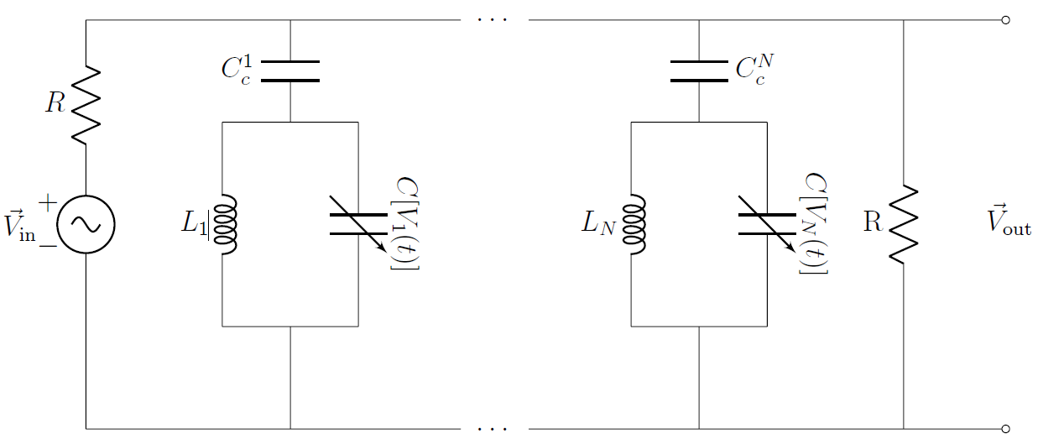
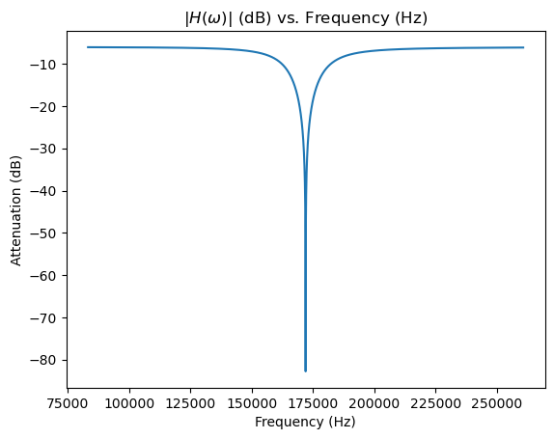
Samantha's First Approximation
PCB prototype using passive LC resonators with varactor diodes
Circuit & Measurements
Initial PCB Prototype
Component | Value
Varactor diode | SMV1255-011LF
Coupling capacitor (Cc) | 120 pF
Blocking capacitors (Cb) | 1 nF
Decoupling resistors | 100 kΩ
Inductors | 2.2 - 10 µH
Resonant frequencies | 2.9 - 6.3 MHz
⊞
Resonator Circuit Schematic
[Insert figure here]
Key Equations (Dissertation Ch. 2)
Resonant frequency:
ω₀² = 1 / [L(C₀ + Cc)]
FWHM bandwidth:
Δω_FWHM = R / (L·√12)
Limitation: Q not optimized. Operating at 2.9-6.3 MHz, not target 50-200 MHz for transcutaneous WPT.
Resonant Electrophysiology - UCLA/UCI Collaboration
9 / 16

Slide 10
Key Challenges to Solve
What must change from Samantha's first approximation
FREQUENCY
QUALITY
GROUNDING
Move to 50-200 MHz
Achieve Q ≥ 1667
Eliminate Ground Inside Body
Why it matters:
Why it matters:
Why it matters:
Required by capacitive coupling through skin for WPT
Notch BW must be ≥5× narrower than channel spacing for low crosstalk
Signal ground cannot exist inside human tissue — needs balanced topology
Current: 2.9-6.3 MHz
Current Q (passive): ~25-50
Current: notch to ground
Target: 50-200 MHz
Target Q: 1667 - 6667
Target: differential between TL nodes
Resonant Electrophysiology - UCLA/UCI Collaboration
10 / 16

Slide 11
Proposed Approach: Active Q-Enhancement
Cross-coupled negative-gm circuits to boost Q from ~50 to 1667+
Why active?
Passive LC in tissue achieves Q ≈ 25-50. We need Q ≥ 1667. Cross-coupled NMOS pair adds a negative resistance (R_neg = −2/gm) that cancels tank losses, multiplying Q.
Q-Enhancement Formula
Operating Regions
Q_enh = Q₀ / (1 − gm·Rp/2)
gm·Rp/2 < 1
Q-enhanced filter (STABLE)
gm·Rp/2 = 1
Barkhausen threshold
As gm·Rp/2 → 1, Q → ∞ (oscillation threshold)
gm·Rp/2 > 1
Oscillator (unstable for FDM)
CIRCUIT
FABRICATION
POWER
Cross-Coupled NMOS Pair
IGZO Thin-Film Process
Implantable Battery Required
Provides negative resistance in parallel with LC tank
150 µm footprint achievable at UCI INRF (Cuervo lab)
Active circuits need 1-5V bias from Li-ion cell + wireless charging
Resonant Electrophysiology - UCLA/UCI Collaboration
11 / 16

Slide 12
Simulation Results: Active Q-Enhancement
LTspice validation of negative-gm cross-coupled topology
⊞
⊞
Cross-Coupled Circuit Schematic (LTspice)
Notch Comparison: Passive vs Active
[Insert figure here]
[Insert figure here]
Key Findings from Simulation
f₀
Q passive
Q enhanced
Notch depth
50 MHz
~85
~800+
−40 dB
Achieved target band (low end)
With L = 405 nH, Rs = 1.5 Ω
Approaching Barkhausen threshold
Clear improvement over passive
Resonant Electrophysiology - UCLA/UCI Collaboration
12 / 16

Slide 13
Next Steps & Optimization
Path from Q ≈ 800 to Q ≥ 1667
Optimization Levers
Resources Needed
Reduce inductor Rs
Real PDK access
Use Coilcraft RF inductors (Rs < 0.5 Ω). Q₀ scales as 1/Rs.
TSMC 180 nm or GF 130 nm BSIM models
Increase W/L of MOSFETs
Behavioral varactor SPICE model
More gm per mA. Move from default to W/L = 10-50.
Time-domain EMG modulation simulation
Cascade two resonators
EM simulator (HFSS/CST)
Effective Q ≈ 1.55× single stage with same components.
Inductor Q optimization at 50-200 MHz
Better MOSFET model (BSIM3/4)
Sync with Samantha & Cuervo
Move from Level 1 to real PDK (TSMC 180 nm).
DSP-circuit interface specs + IGZO process limits
Resonant Electrophysiology - UCLA/UCI Collaboration
13 / 16

Slide 14
Discussion
Open questions for the team
1
Is Q ≥ 1667 achievable with IGZO TFT-based varactors, or do we need silicon for this?
2
Should we prototype at 50 MHz first or jump directly to 100+ MHz target?
3
What is the realistic timeline for moving from LTspice simulation to fab tape-out?
4
Active Q-enhancement adds power and complexity — what is the team's risk tolerance?
5
How does the team prefer to validate: simulation milestones, PCB prototype, or directly to IC?
Thank you

Slide 15
TEMPLATE: Section Divider
SECTION
Section Title
Optional subtitle or descriptive text for this section

Slide 16
TEMPLATE: Two-Column Layout
Slide Title Here
Optional subtitle text explaining the slide content
Column 1 Header
Column 2 Header
First bullet point with description
Second bullet point with more detail
Third bullet point
Fourth bullet point
This column can contain text, an explanation, an image, or any other content. The background color helps distinguish it visually from the left column.
Resonant Electrophysiology - UCLA/UCI Collaboration

Slide 17
TEMPLATE: Big Stat Callout
Headline Statement
Use this layout to emphasize a single key number or fact
Key Stat
99.9%
Subtitle or descriptive context for the statistic
Optional source or attribution
Resonant Electrophysiology - UCLA/UCI Collaboration

Slide 18
TEMPLATE: 3-Card Layout
Three Equal Concepts
Use this layout when comparing or listing 3 related items
01
02
03
First Concept
Second Concept
Third Concept
Description of the first concept, idea, or feature being presented
Description of the second concept, idea, or feature being presented
Description of the third concept, idea, or feature being presented
Resonant Electrophysiology - UCLA/UCI Collaboration

Slide 19
TEMPLATE: Process / Timeline
Process Flow
Step-by-step or chronological progression
1
2
3
4
Step One
Step Two
Step Three
Step Four
Brief description of the first step
Brief description of the second step
Brief description of the third step
Brief description of the fourth step
Resonant Electrophysiology - UCLA/UCI Collaboration

Slide 20
TEMPLATE: Quote / Highlight
“
Place your important quote, key insight, or highlighted statement here. This template draws focus to a single powerful message.
— Attribution or Source

Slide 21
TEMPLATE: Image + Text
Slide with Image
Combine visual content with explanatory text
Description
Main Point Here
Detailed explanation of the image content. This is where you describe what the viewer sees and why it matters for your argument.
⊞
Insert image, chart, or diagram
[Insert figure here]
Key insight number one
Key insight number two
Key insight number three
Resonant Electrophysiology - UCLA/UCI Collaboration

Slide 22
TEMPLATE: Data Table
Comparison Table
Use this layout for structured numerical or categorical comparisons
Parameter | Option A | Option B | Option C | Notes
Row 1 parameter | Value A1 | Value B1 | Value C1 | Comment for row 1
Row 2 parameter | Value A2 | Value B2 | Value C2 | Comment for row 2
Row 3 parameter | Value A3 | Value B3 | Value C3 | Comment for row 3
Row 4 parameter | Value A4 | Value B4 | Value C4 | Comment for row 4
Row 5 parameter | Value A5 | Value B5 | Value C5 | Comment for row 5
Optional footnote or methodology note
Resonant Electrophysiology - UCLA/UCI Collaboration

